Slide 1
MAXIV Status Report
ISPyB meeting
Alberto Nardella
Alberto.Nardella@maxiv.lu.se
HAMBURG MAY 19, 2025

Slide 2
PY-ISPyB developments
Samples
Prepare experiment
Proteins
MX results
DUO synch
SSX results

Slide 3

Results visualization
Experiment | MAXIV | SOLEIL | Status | To be done
Generic Dataset |  |  | 50% | Autoprocessing, Sample tab, Workflow (SOLEIL)
Energy scan |  |  | 100%
XRF scan |  |  | 50-100% | PyMCA panel (SOLEIL if needed)
SSX results |  |  | 0% | Pipeline + results
Mesh scan |  |  | 0%
Line scan |  |  | 50%
BioSAXS |  |  | ?
CryoEM |  |  | ?

Slide 4
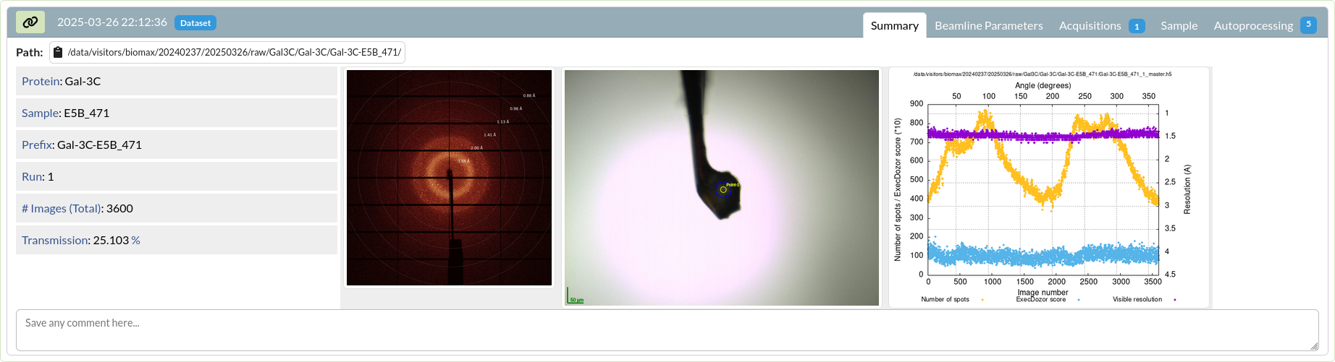
MX Results - Dataset

Slide 5
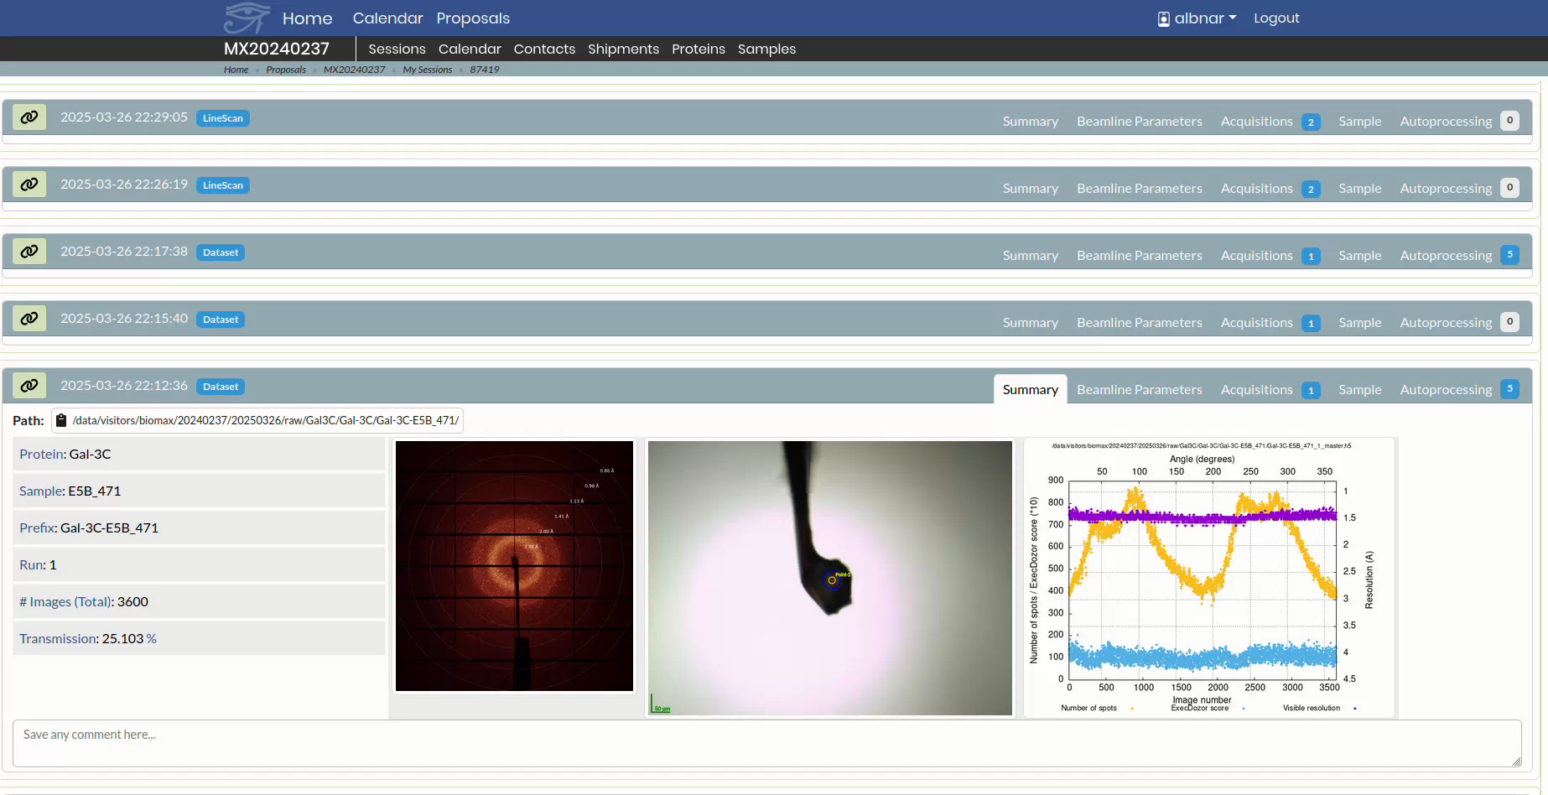
MX Results – Dataset II

Slide 6
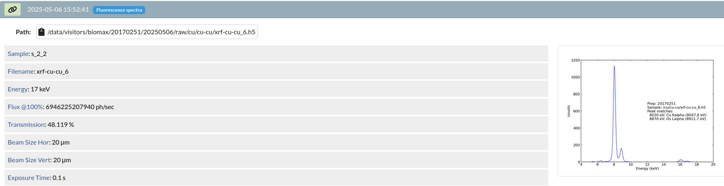
MX Results – XRF Scan

Slide 7
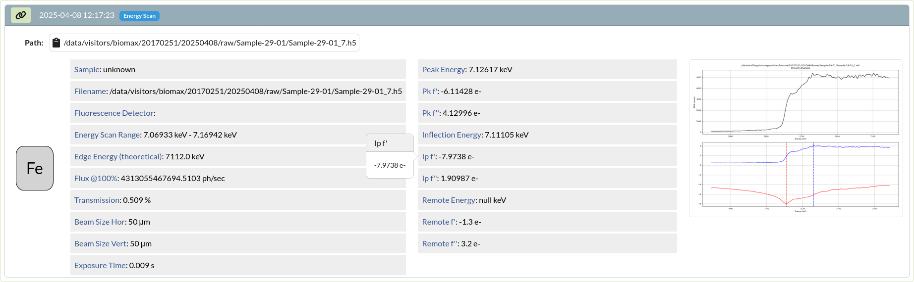
MX Results – Energy Scan

Slide 8
Next steps
^{Prepare experiment}
^{Results}
^{ISARA Sample Changer}
^{Sample tab}
^{SSX panel}
^{Room Temperature}
^{Pipelines results info}
^{Summary panel}
^{Improvements}
^{User eXperience}
Keeping dependencies up-to-date

Slide 9
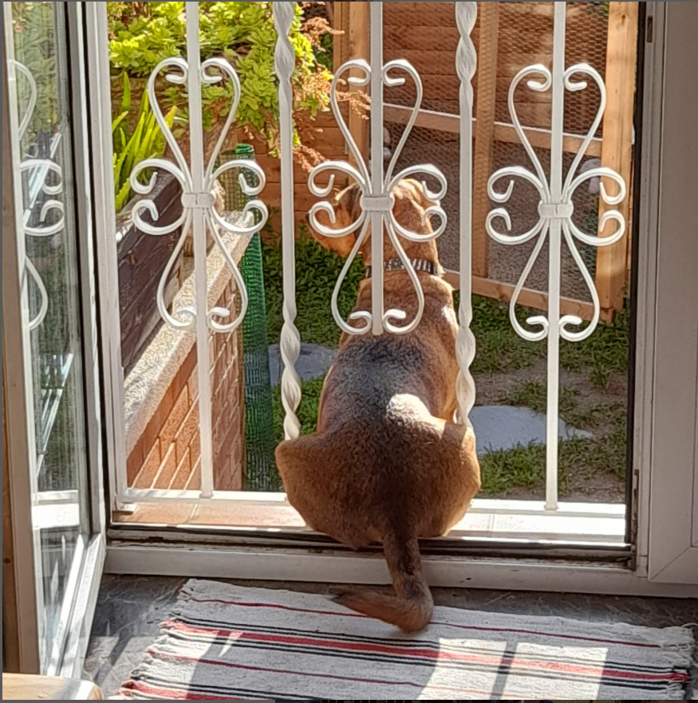
Thank you

